Slide 1
THE BATTLE OF NEIGHBORHOODS
Yashwanth Thatavarthi

Slide 2
INTRODUCTION
Toronto city overview for ABC Grocery
ABC Grocery Strategic Plan and Overview
ABC Grocery Business Problem
Choice of the first neighborhood to offer services.
The neighborhood should enable easy replication.
The neighborhood should have high demand.
The neighborhood should have lower competition.
Success Criteria:
Good recommendation of neighborhood that meets above points.
It should have capability to enable latest information whenever required.

Slide 3
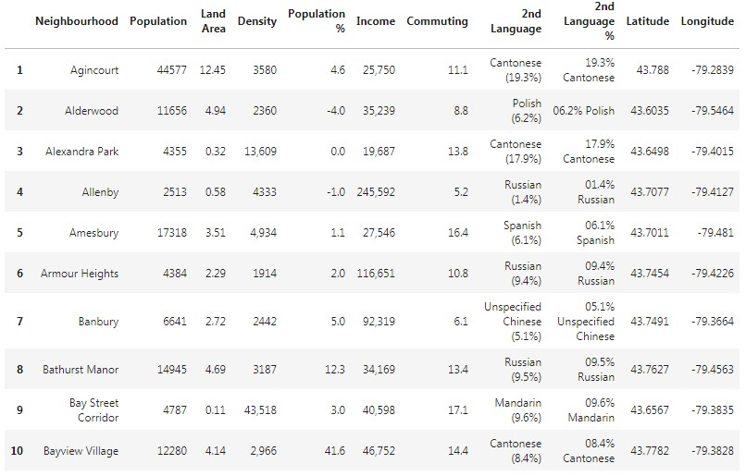
DATA DESCRIPTION
Data Requirements for this project:
Neighborhood Information (i.e. name, coordinates, populations).
Venue information (i.e. name, category, coordinates)
Data Sources for this project:
Wikipedia Pages
Foursquare.com
Data Processing for this project:
Data cleaning is required
Data needs to be in a structured format

Slide 4
Data Scrapping Technique
To scrap the neighborhood data from Wikipedia
To make the data into a structured format
Foursquare.com
Retrieving venue information from above API.
K-Means Machine Learning
Segment and cluster similar neighborhoods
Group them based on most common venues
Scoring Weightage
Population count has 50% weightage
Venue (fewer grocery) has another 50% weightage
METHODOLOGY

Slide 5
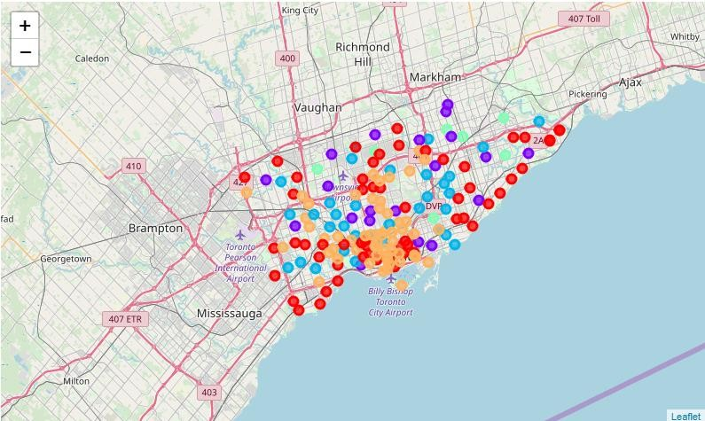
RESULT
Clustering Similar Neighborhoods
Grouping based on common venues
Neighborhood with high population
Topmost common venue
Ranking the neighborhoods based on common venue w/o Grocery
Ranking the neighborhoods based on population count

